Slide 1
Project Overview and Advisory Board Interaction Coordinator: fortiss, Rute C. Sofia (sofia at fortiss dot org)

Slide 2
OVerview
CODECO aims at assisting in supporting the Edge-Cloud continuum via the development of a cognitive, decentralised Edge-Cloud framework.
Main Challenges
5G/6G smart services
Dense environments
Mobility
High portability
Far Edge to Cloud
Highly adaptive Edge-Cloud
management framework (TRL4-5) that integrates a unique, smart, and cross-layer orchestration between the
decentralised data flow, computation, and networking services
Vision

Slide 3
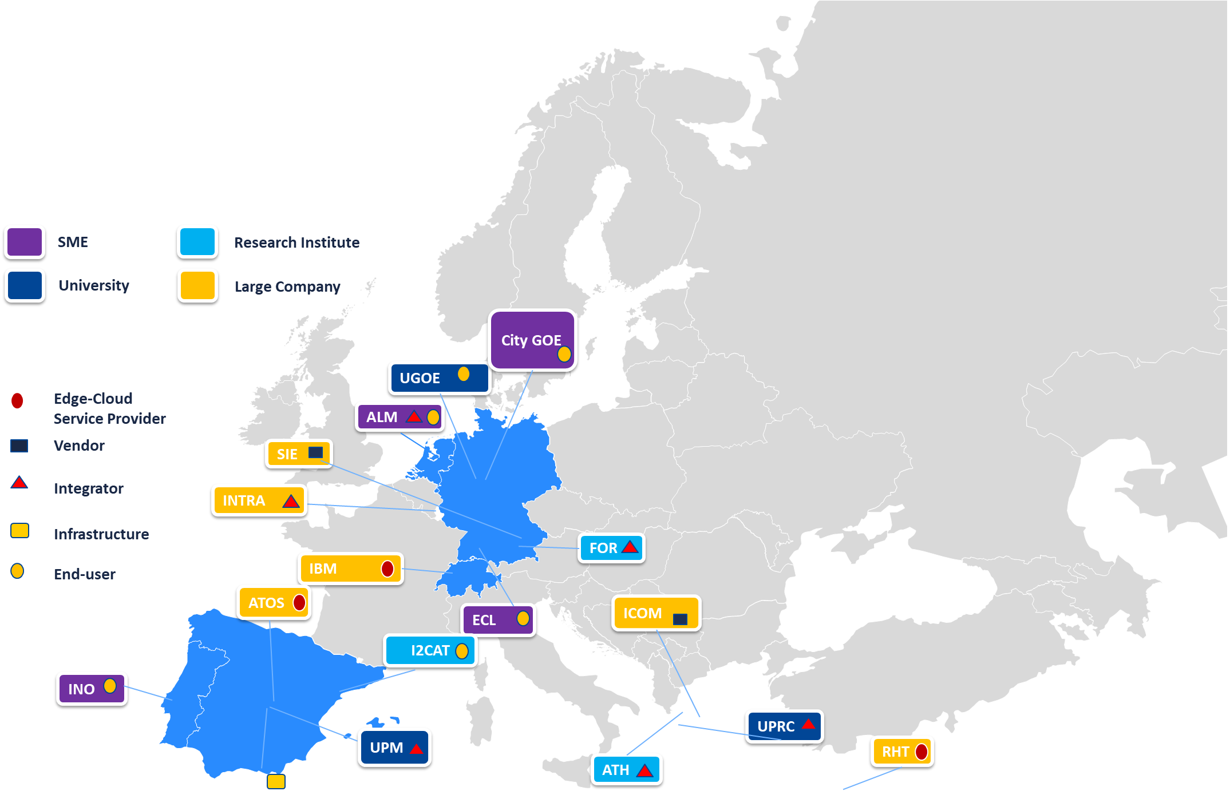
COnsortium

Slide 4
ECosystem
ICT: Industry, SMEs
EUS: End-user, Public
Smart Cities
Energy
software
A1
A2
CODECO Initial Target Markets
GOV: Municipalities, policy makers, government
SDO: Standardisation and Open-source communities
A6
CODECO Assets
A5
A3
CODECO Target Stakeholder Groups
A4
Smart Buildings
AR: Academia and Research
Manufacturing
DEV: App developers and early adopters

Slide 5
Objectives
Simplification & Automation
O2: Optimize Edge-Cloud Operation via a privacy-preserving data-compute-network orchestration
Security & Privacy Preservation
O3: Provide automated, privacy preserving secure management for multi-clusters
Openness & Greenness
O4: Support multi-domain Edge Cloud operations integrating openness and greenness
Broad
Impact
O5: Build a consolidated ecosystem appealing to the different CODECO stakeholder groups
O1: Reduce Edge-Cloud Setup and Management Time
Data-compute-network
Orchestration

Slide 6
Assets
Open, cognitive toolkits and smart App
Open-source Eclipse repository
Training Database
integrating the elastic and advanced concepts to manage, in a smart and flexible way, containerized applications across Edge and Cloud dynamic cluster and multi-cluster environments.
A developer-oriented open-source software repository, to be available in an early stage of the project, thus allowing for early exploitation of initial, advanced results and a better adaptation throughout the project lifetime.
Training tools and events, to support the development of services based on the CODECO framework.
A1
A2
A3
Edge-Cloud Use-cases
R&I Engagement Programme
Open Experimental Framework
Research and Innovation Community Engagement Programme and multiple community events, based on the different use-cases and including the different CODECO stakeholders.
CODECO framework integration into the large-scale EdgeNet4, experimental infrastructure, to assist in the building of experimentation and novel concepts by the research community.
A4
6 Use-cases across 4 domains (Smart Cities, Energy, Manufacturing, Smart Buildings), to be deployed in operational environments.
A5
A6

Slide 7
Use-cases
P1: Smart Monitoring of the Public Infrastructure
Lead: UGOE/City of Göttingen
VP: Improved QoE
Goals: Smart Monitoring of e.g., road status, traffic congestion
P2: Vehicular Digital Twin for safe urban mobility
Lead: I2CAT
VP: Increasing road safety
Goals: Vehicular digital twin for safe urban mobility
Mobility
Smart Cities
P3: Media Delivery Streaming (MDS) across Decentralised Edges Use-case
Lead: TID
VP: Combined optimization of Edge-Cloud and networking resources for MDS.
Goals: Resource-efficient usage via context-aware selection of MDS points
P4:Collective Demand Side Management in Decentralised Grids
Lead: UPM
VP: Improved energy management based on Edge computing.
Goals: Smart monitoring of the energy generation, consumption, storing and availability
Energy
P5:Decentralised, wireless AGV Control for Flexible Factories
Lead: FOR
VP: Increased AGV autonomy and scalability via decentralized wireless control.
Goals: Decentralised ML/AI to assist energy reduction based on network adaptation.
P6:Smart Buildings
Lead: ALM
Value proposition: flexible far Edge-Cloud data processing
Goals: Smart management of Crownstone meshes and their distributed applications
Manufacturing

Slide 8
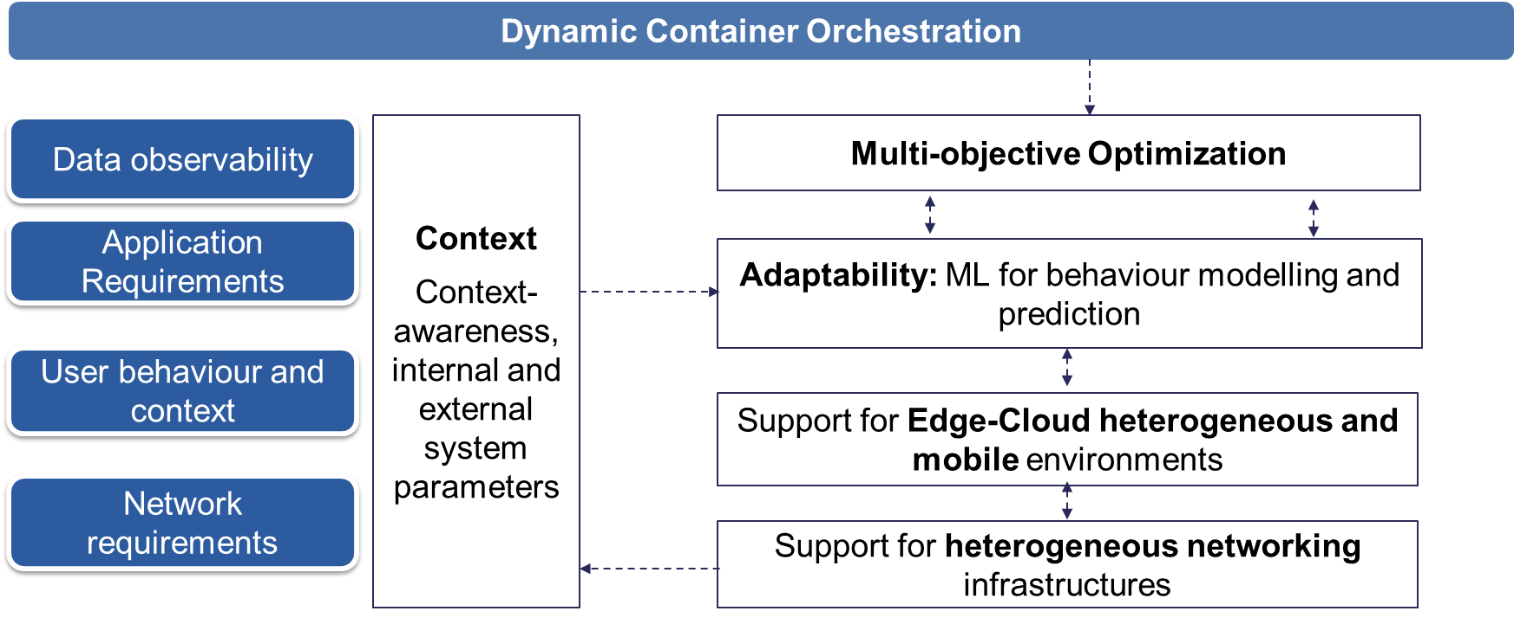
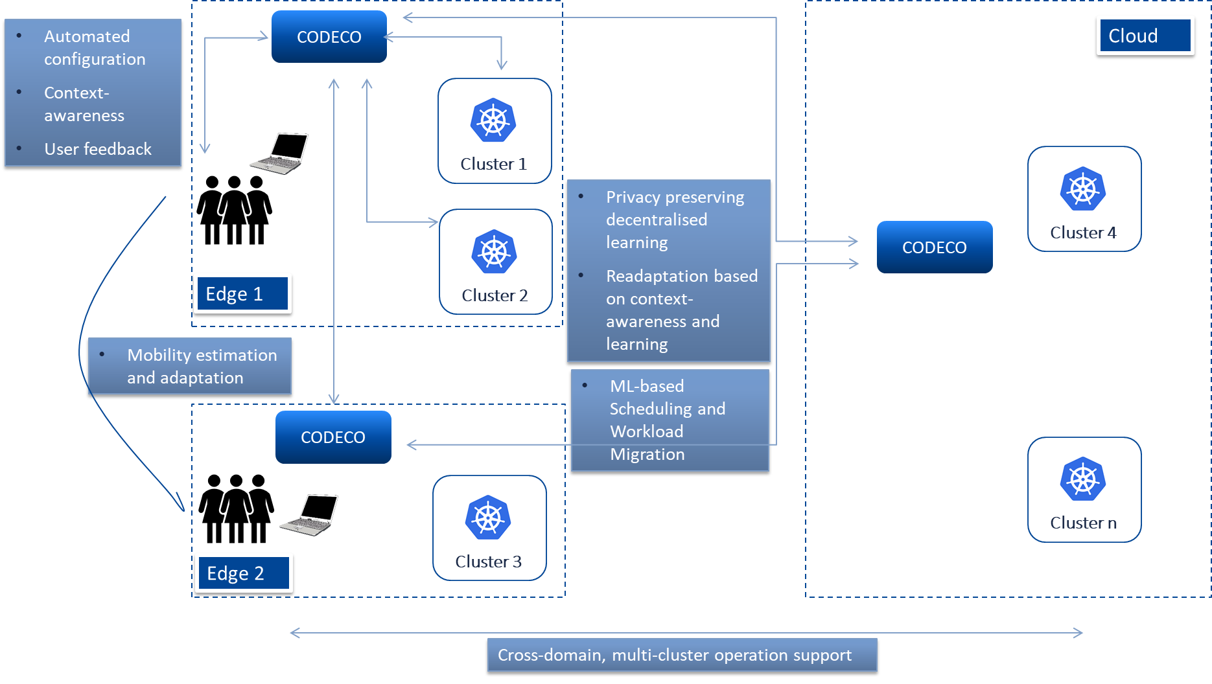
Concept

Slide 9
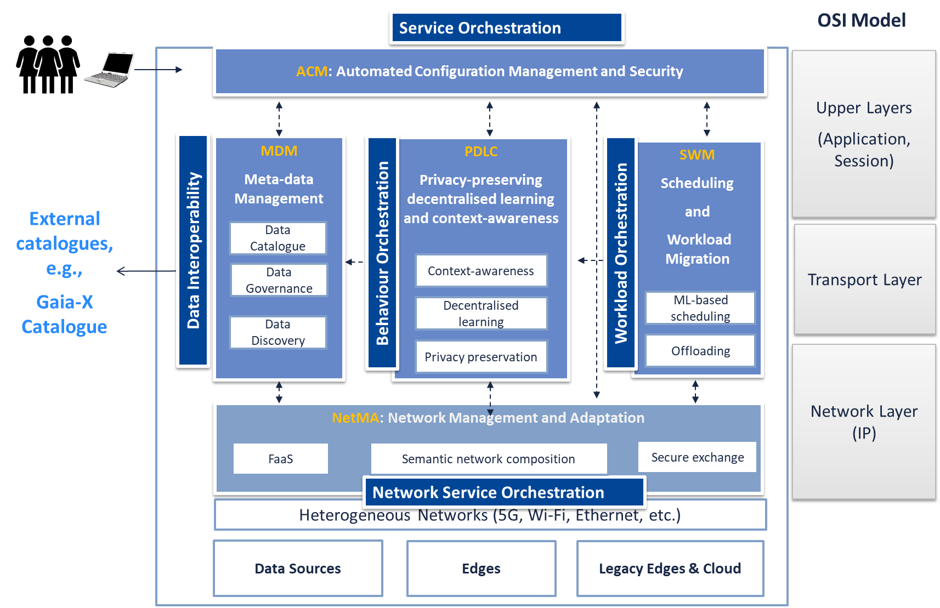
Components
ACM
PDLC
SWM
Zeroconfig
Privacy
Support for embedded devices
User interfacing
MDM
Meta-data management and discovery
Context-awareness
Decentralised learning
Multi-objective scheduling
ML-based workload migration
NetMA
Network exposure
Network adaptation
Secure data exchange
Privacy Preservation

Slide 10
Approach
Single Cluster Operation: first 18 months
Use-cases, ecosystem
Operation within 1 cluster
Modular approach, implementation and validation of individual blocks (ACM, MDM, etc)
Software release – open basic toolkit
M9, early release
M18 final release
Single cluster validation and performance evaluation
Data-compute-network
Experimentation, testing, demos
Federated Clusters Operation: last 18 months
Public awareness, scientific, industrial impact
Multi-cluster domains
Modular approach, focus on decentralised learning for heterogeneous mobile Edge-Cloud domains
Software release
Demos

Slide 11
Development

Slide 12
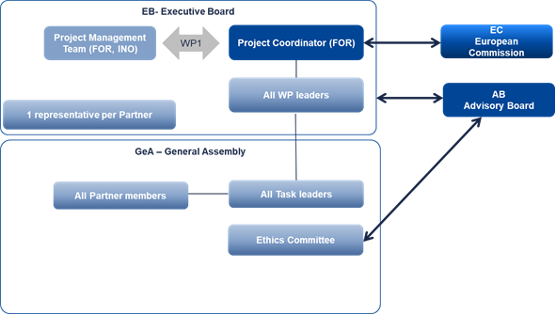
Governance
AB – External Expert Advisory Board (EEAB accordingly with the Consortium Agreement)

Slide 13
CODECO AB – EEAB (External Expert Advisory Board)
Name | Affiliation | Profile | Profile
Maria João Barros-Weiss | IONOS SE | VP of Research Digital Ecosystems at IONOS, Germany | providing support towards standardization and business models
Richard Yang | Department of Computer Science Computer Systems Lab at Yale Yale University, USA | Full Professor | Provides support towards the compute-network and network-application integration aspects of CODECO
Charles Sheridan | Google Ireland | EMEA Technical Director, Industry Solutions, Manufacturing, Google (Ireland) | supporting the business impact for multi-cluster multi-cloud industrial environments
Paulo M Mendes | Airbus | Expert Network Architectures at Airbus, Germany | provides support and advising the CODECO applications towards new frontiers in aeronautics
Yuanyuan Yang | Stonebrook University, USA | Distinguished Professor | Provides support towards the Edge computing and decentralized systems
Roch Guerin | Washington University at St. Louis, USA | Department Chair Harold B. & Adelaide G. Welge Professor of Computer Science | Support for the Edge-Cloud orchestration aspects, in particular far Edge
7 international experts (currently, 5)
Academia and Industry
Profiles aligned with the CODECO technical, societal and business needs

Slide 14
CODECO AB – EEAB (External Expert Advisory Board)
Formalities
Meetings
Once per year, Q4 plenary (hybrid meeting); 2-3 hour meeting
Invitations to relevant CODECO meetings, e.g., CODECO workshops
Support
Advice in the development of key assets
Advice in the development and deployment of use-cases and demos
Proposal for new action points derived from presentations
Support backed up by presentations/videos/summary sent at least 15 days before the EEAB meeting
Material
EEAB officially established since this plenary, month 3 of CODECO (M3)
Non-disclosure unilateral, letter of commitment sent by FOR – protection of disclosed Confidential Information – to be sent until April 20th 2023

Slide 15
THANK YOU for your attention!
Questions?
15

Slide 16
MEET OUR Consortium
16

